Slide 1
Practical Security
Modern-Day Software

Slide 2

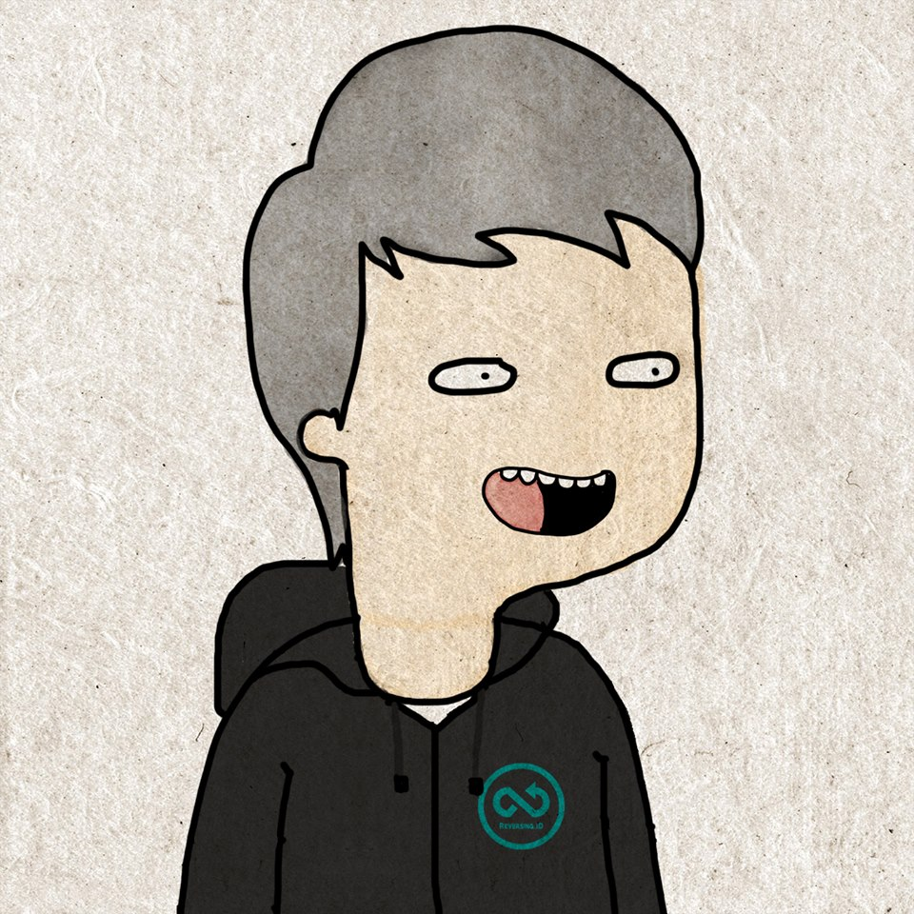



Hi!
I am Satria Ady Pradana
Community Leader
of
Reversing.ID
xathrya
@xathrya
Reversing.ID
Revealing the Truth through Breaking Things

Slide 3
Agenda
Common Mistakes / Pitfalls
Common Attacks
Common Mitigations

Slide 4
Current Ecosystem in Software Development

Slide 5
Modern Software is …

Slide 6





Connected …
Notes:
Dulu monolithic sekarang network based

Slide 7

Layered …
Stack of Components

Slide 8
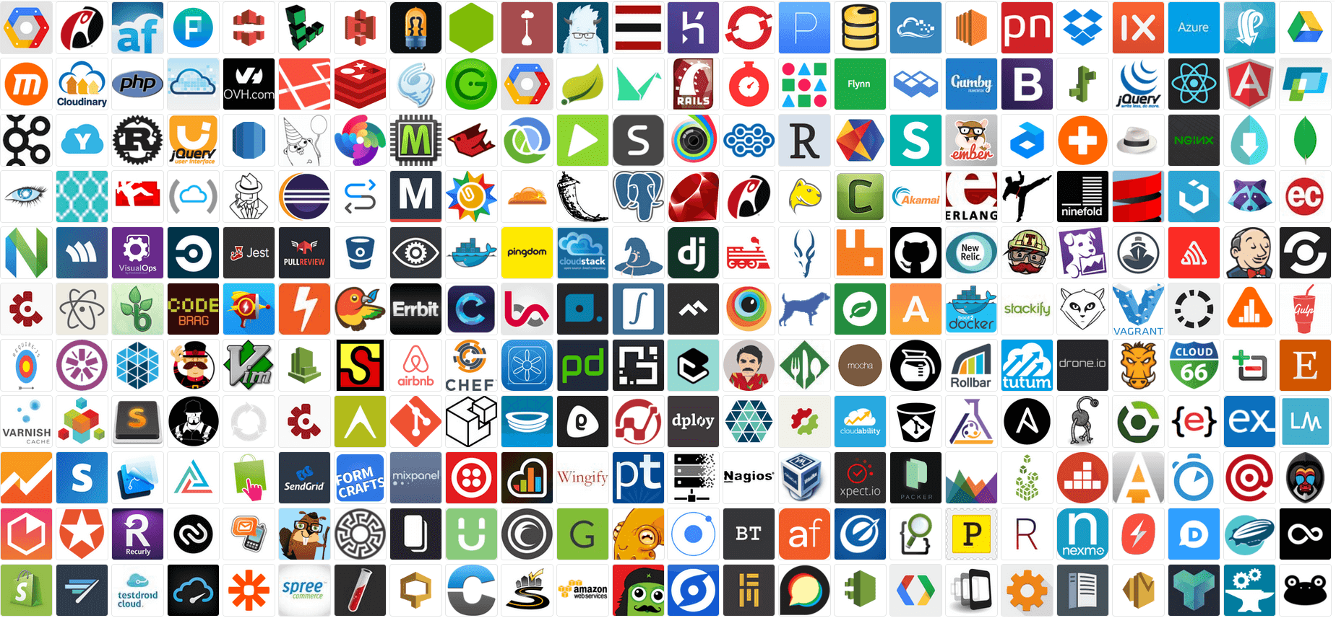
Complex …

Slide 9
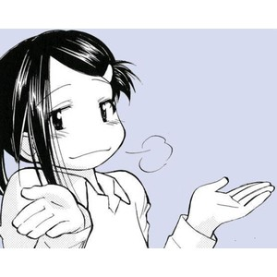
“Meh… I don’t care”
@hacker

Slide 10
But more complex means More attack vectors
We like it

Slide 11
I just care about
Stored
Processed
Transmitted
And you should too …

Slide 12
Wrong Assumptions
It’s applied only to web application or web service
HTTPS

Slide 13
Notes:
Makin kompleks, banyak komponen,

Slide 14

IDOR
Attack on Code
Insecure Direct Object Reference

Slide 15
Instance:
Unauthorized access to (restricted) resource.
Access / modification to resource owned by other account.
It’s purely logic
To mitigation:
Check for authorization.
Check the ownership.

Slide 16

Injection
Attack on Code
SQL
LDAP
XML
JavaScript
Commands

Slide 17
Instance:
Enumerate data from databases (user, transactions)
In some cases: write file to system
Execute arbitrary command (OS, programming language).
Mitigation:
Filter any character that makes up query.
Filter some syntaxes that appear in input.

Slide 18
Never (Blindly) Trust Any Inputs
That’s Old Words
Show me some interesting things

Slide 19
Demo
HTML Injection
Server-Side Template Injection in Flask

Slide 20
Forgotten Artefact
Attack on Deployment

Slide 21
Instance:
Configuration files (and mostly has access notes about password and stuffs)
The code versioning directory
Mitigation:
Cleanse the development related files in production area.
Remove the .git folder (whatever code versioning).
No storing sensitive data in plaintext

Slide 22
Unobfuscated Binary
Attack on Binary

Slide 23
Instance:
Reading the all the logic / flows in applications
Manipulate (easier)
Recover tokens, algorithm, anything you conceal.
Reproduce counterfeit or tampered binary.
Mitigation:
Obfuscate.
Ps: not 100% guaranteed.

Slide 24

Questions?

